Slide 1
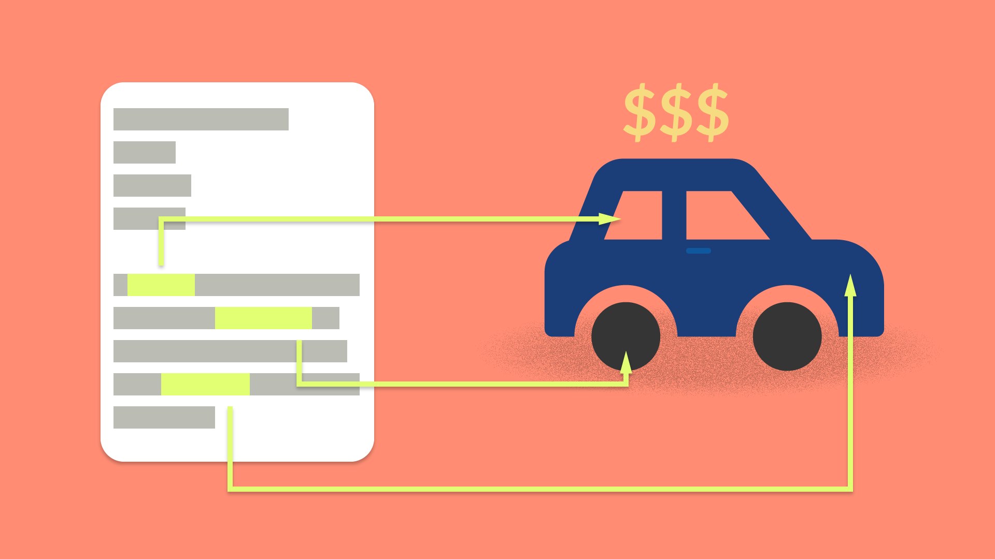
19CSE305 Machine Learning
Car Price Prediction
Group-7
Abhay Das
Devesh Kumar
Sreesankar S
Vaishakh S Krishnan
Vignesh A Nair

Slide 2

Introduction
What made us to work on the project?
Everything about the Dataset
Reason behind the Algorithms
Insights and Finding
Let's wrap
Agenda 101
What to Know
Random Fact:
Data is like people – interrogate it hard enough, and it will tell you whatever you want to hear.

Slide 3


Getting Started
Some car buyers will suffer a lot of problems like dealer may charge amount more than the car value.
This model can help them to predict the actual and reasonable price of those used cars.

Slide 4
Our model uses data available with price of the cars in the present market keeping all the important factors in mind and calculating an estimated price in the present date without asking help from a third party.
Our model predicts result based on the amount of test data so that it wouldn’t depend on some wrong of price listings by few customers.

Slide 5


Motivation behind

Slide 6
What made us to work on this area?
Realistically speaking second hand cars might look like a better deal in the long run if we can manage to find a great car for the value it is bought. It might seem easy for me to predict a car’s price as I am familiar with the car prices, the demand, liking and the safety reasons a car might have but to a normal person it might all confuse a person and he would instead get a new one or a person who wants to buy a second vehicle who doesn’t have any prior knowledge of markets and how they should be priced will be taken advantage of.

Slide 7

Everything about dataset!

Slide 8
Dataset

Slide 9



Random Forest
Algorithms
Linear Regression
A closer look at the benefits of
these algorithms.
GBT

Slide 10

Random Forest
Supervised Learning Technique
It can be used for both Classification and Regression problems. Based on the concept of ensemble Learning.

Slide 11

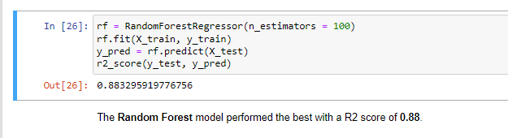
We can see that the Accuracy is 88% when we use the Random Forest Algorithm

Slide 12

Linear Regression
Supervised Learning Technique
It is a statistical method that is used for predictive analysis. Linear regression makes predictions for continuous/real or numeric variables

Slide 13
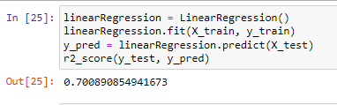
We can see that the Accuracy is 70% when we use the Linear Regression Algorithm.

Slide 14

GBT
Supervised Learning Technique
Gradient Boosted Trees (a.k.a GBT) is a commonly used tree-based ML algorithm which works for both regression and classification type of data mining problems

Slide 15
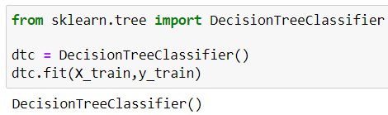
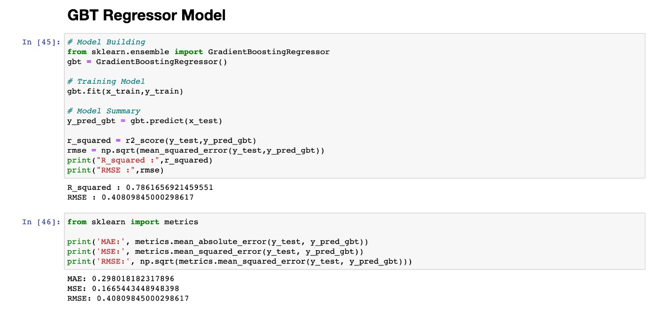
We can see that the Accuracy is 78% when we use the GBT Algorithm.

Slide 16


Results and Analysis

Slide 17
Result of Algorithms
Accuracy:
Random Forest: 88%
GBT: 78%
Linear Regression: 70%
The accuracy of Different Machine learning Algorithms we used are compared using the bar graph we can say RF > GBT> LR .

Slide 18
It's a Wrap
Here comes our conclusion...

Slide 19

Conclusion

